Slide 1
Report on the 5th IUPAP International Conference on Women in Physics
(Conference Supported by IUPAP Working Group on Women in Physics)
Beth A. Cunningham, AAPT
Cherrill Spencer, ex-SLAC National Accel. Lab
Anne Cox, Eckerd College

Slide 2
Report on the 5th IUPAP International Conference on Women in Physics
(Conference Supported by IUPAP Working Group on Women in Physics)
Beth A. Cunningham, AAPT
Cherrill Spenser, SLAC
Anne Cox, Eckerd College

Slide 3

Two Goals:
Resolutions from Conference
Introduce the video: HERStories

Slide 4
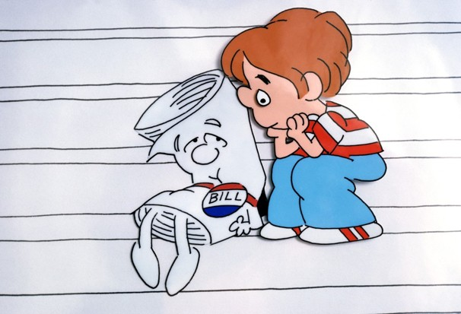

Two Goals:
Resolutions from Conference
http://www.giftedguru.com/wp-content/uploads/2012/03/schoolhouse-rock.gif
http://justicefergie.com/wp-content/uploads/2013/01/15211_17-PH20040504_159-.jpg
http://schooltube-thumbnails.s3.amazonaws.com/f6/83/36/78/96/c6/f6833678-96c6-11e1-842e-001c23dcdfb5_lg.jpg
http://www-tc.pbs.org/wnet/blueprintamerica/files/2010/02/The-Bill-300x231.jpg

Slide 5
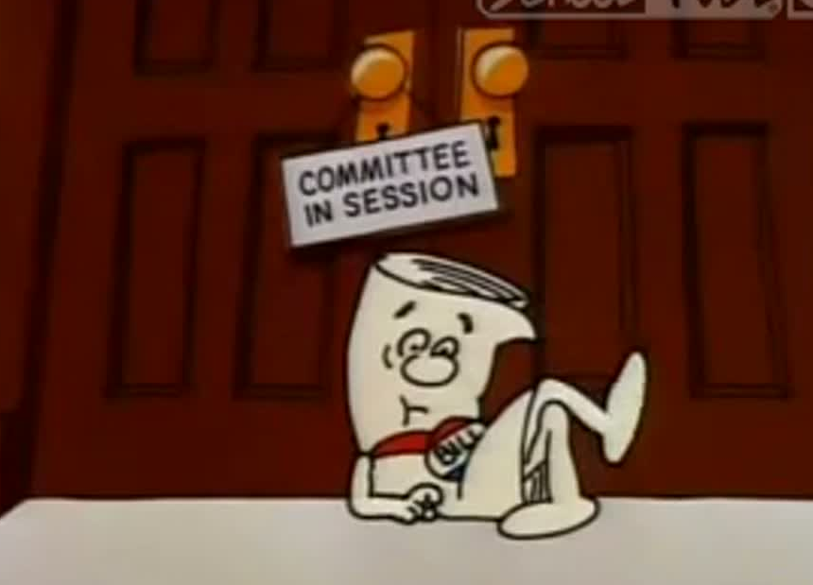
Resolutions
Workshop: Improving the Workplace
Presentations:
  Canadian workplace policies
  Project Juno (Institute of Physics to Physics Departments to address “leaky pipeline”)
Discussion
Recommendations:
  Societies adopt a Juno-like project
  Propagate Best Practices from Project Juno

Slide 6
Resolutions
Workshop: Improving the Workplace
Presentations:
  Japan: Hours in lab
  US: Mutual mentoring
  India: Google group
Discussion
Recommendations:
  Continued data collection
  International Women in Physics Day

Slide 7
Resolutions
Workshop: Improving the Workplace
Presentations:
  Canadian workplace policies
  Project Juno (Institute of Physics to Physics Departments to address “leaky pipeline”)
Discussion
Recommendations:
  Societies adopt a Juno-like project
  Propagate Best Practices from Project Juno

Slide 8

Resolutions
Plenary
1. Share strategies for inclusion and advancement of women in physics.
2. “Waterloo Charter” based on Baltimore Charter and Pasedena Recommendations by American Astronomical Society. Charter shaped by principles from Project Juno.

Slide 9
Resolutions
Workshop: Improving the Workplace
Presentations:
  Japan: Hours in lab
  US: Mutual mentoring
  India: Google group
Discussion
Recommendations:
  Continued data collection
  International Women in Physics Day

Slide 10
Resolutions
Plenary
3. Regular updates of Global Survey of Physicists.
4. Future analysis of Country data.
5. Endorse an annual International Women in Physics Day.
6. IUPAP conferences include outreach activities.
7. 6th Intl Conf on Women in Physics.

Slide 11
Resolutions
Plenary
6. IUPAP conferences include outreach activities.
7. 6th International Conference on Women in Physics.

Slide 12
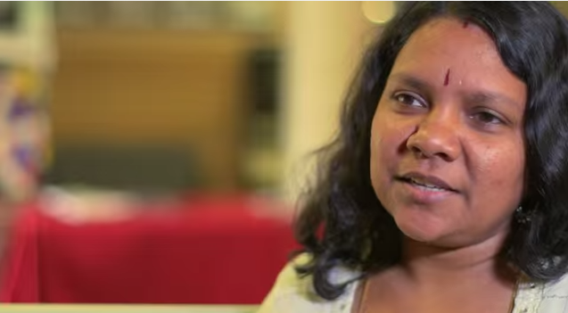
Two Goals:
Introduce the video: HERStories

Slide 13

HERStories:
Wisdom & Encouragement from Women in Physics

Slide 14
HERStories:
Wisdom & Encouragement from Women in Physics
Questions:
Introduce yourself
Why Physics?
Challenges?
Advice for school girl?

Slide 15
HERStories:
Wisdom & Encouragement from Women in Physics
Uma Das

Slide 16
HERStories:
Wisdom & Encouragement from Women in Physics
Video captures the essence of the interviews
Similarity of experiences

Slide 17
HERStories:
Wisdom & Encouragement from Women in Physics
Next steps…
  Teaching resources based on video
  …?

